Slide 1

Workflows, wszędzie widzę workflows -
Camunda Zeebe jako stary (ale wciąż jary)
silnik BPMN-owy
Author: Łukasz Prusiel

Slide 2
About me
Previously:
Application Architect at Softserve
Bialystok Technical University - instructor
Blue Rider Software - Tech Lead
Currently: Senior Tech Lead at Vobile Inc.
Author: Łukasz Prusiel

Slide 3
About me
PyStok:
member since 1st meet-up
twice as speaker
#gstrip #pystok_rower
Author: Łukasz Prusiel

Slide 4

Author: Łukasz Prusiel

Slide 5
About Vobile
Website: vobile.com
World’s leading SaaS provider for digital content assets protection transaction
Author: Łukasz Prusiel

Slide 6
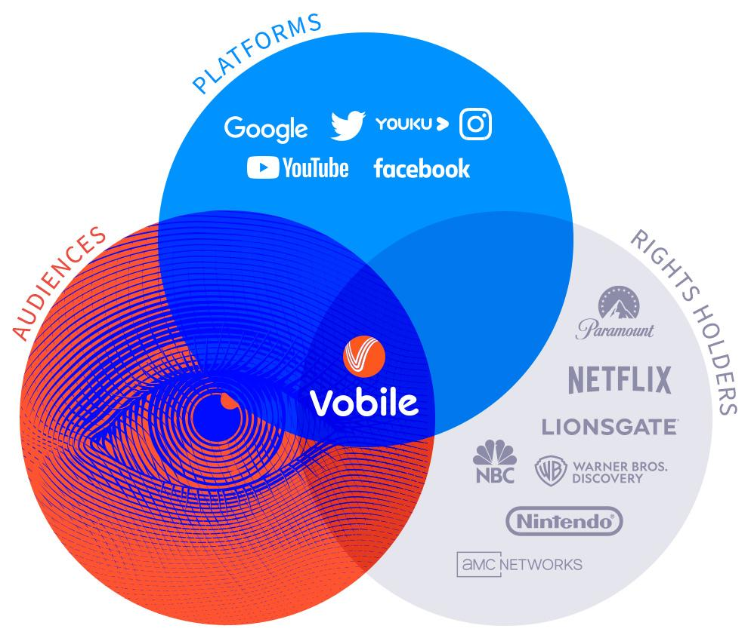
About Vobile
Source: https://vobile.com/
Author: Łukasz Prusiel

Slide 7
About Vobile
Products:
RightsID (Facebook, YouTube)
Video Tracker (open web)
IP Echelon (P2P)
Author: Łukasz Prusiel

Slide 8
About Vobile
DMCA - Digital Millennium Copyright Act
WIPO - World Intellectual Property Organization
Author: Łukasz Prusiel

Slide 9
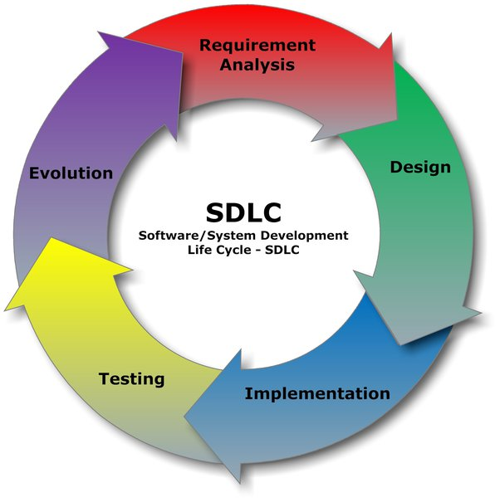
Software engineering
… is a field of engineering, for designing
and writing programs for computers
or other electronic devices
SE defines good practices about coding/
preparing a design (documentation).
Source: https://www.quora.com/What-is-the-software-engineering-process
Author: Łukasz Prusiel

Slide 10
Documentation
Documentation costs, but lack of documentation costs even more.
Author: Łukasz Prusiel

Slide 11
Software engineering
Requirements (Functional and Non-functional)
Software design (UML, BPMN)
Implementation (coding)
Testing (unit, functional, integration)
and repeat …
Author: Łukasz Prusiel

Slide 12

UML
… is a general-purpose modeling language that is intended to provide a standard way to visualize the design of a system
Source: https://en.wikipedia.org/wiki/Unified_Modeling_Language
Author: Łukasz Prusiel

Slide 13
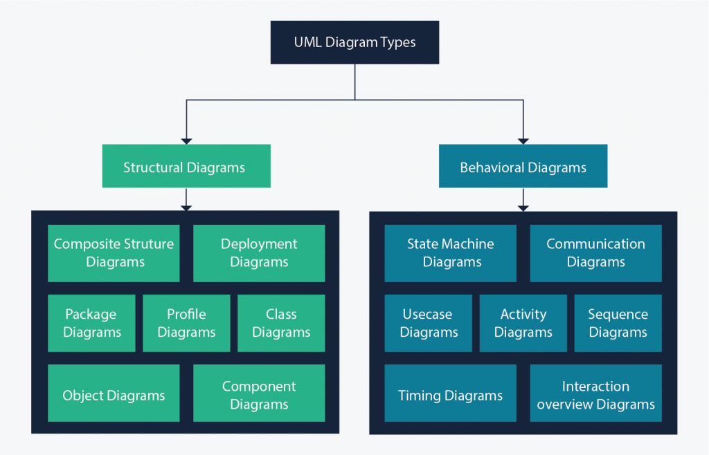
UML
Source: https://creately.com/blog/diagrams/uml-diagram-types-examples/
Author: Łukasz Prusiel

Slide 14
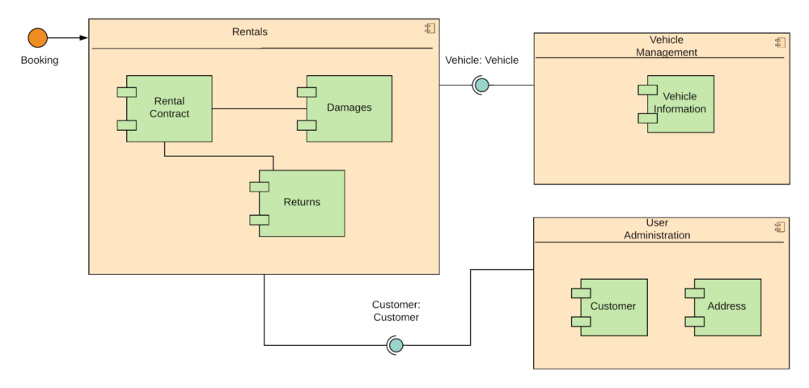
UML
Structural Diagram example
(Composite Structure
Diagram)
Source: https://tallyfy.com/uml-diagram/
Author: Łukasz Prusiel

Slide 15
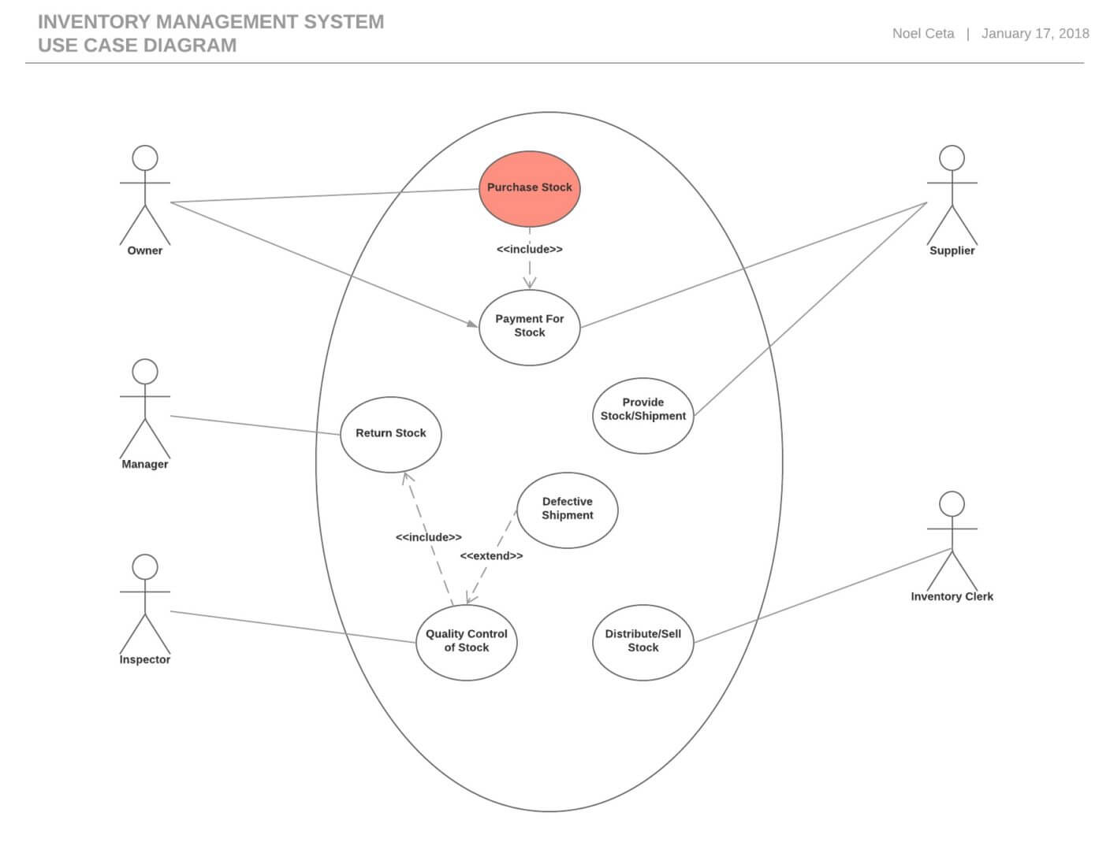
UML
Behavioral Diagram example
(Use Case Diagram)
Source: https://tallyfy.com/uml-diagram/
Author: Łukasz Prusiel

Slide 16

BPMN
Business Process Model and Notation
Source: https://www.bpmn.org/
Author: Łukasz Prusiel

Slide 17
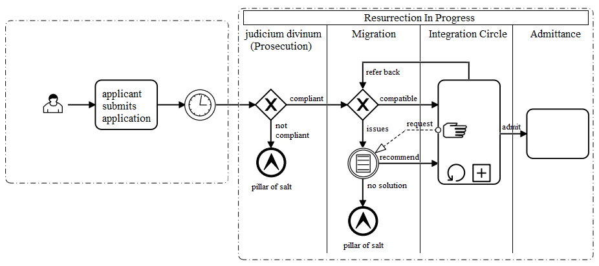
BPMN
…is very similar to activity diagrams from Unified Modeling Language (UML)
Source: https://www.bpmn.org/
Author: Łukasz Prusiel

Slide 18

BPMN Components
Start/end event (for processes and sub-processes)
Author: Łukasz Prusiel

Slide 19

BPMN Components
User and service tasks
Author: Łukasz Prusiel

Slide 20

BPMN Components
Send and receive message events
Author: Łukasz Prusiel

Slide 21
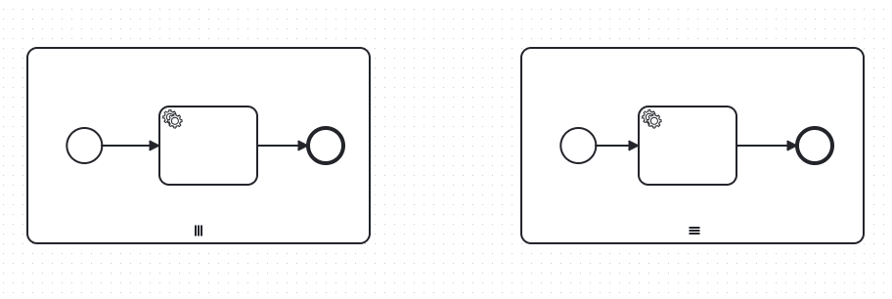
BPMN Components
Parallel and sequential subprocesses
Author: Łukasz Prusiel

Slide 22
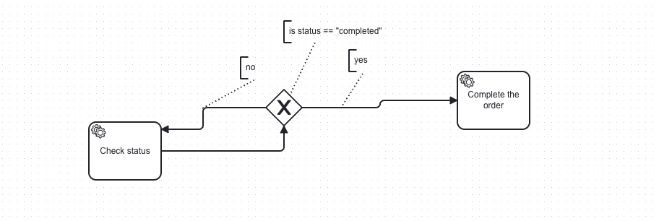
BPMN Components
Gateways (exclusive)
Author: Łukasz Prusiel

Slide 23
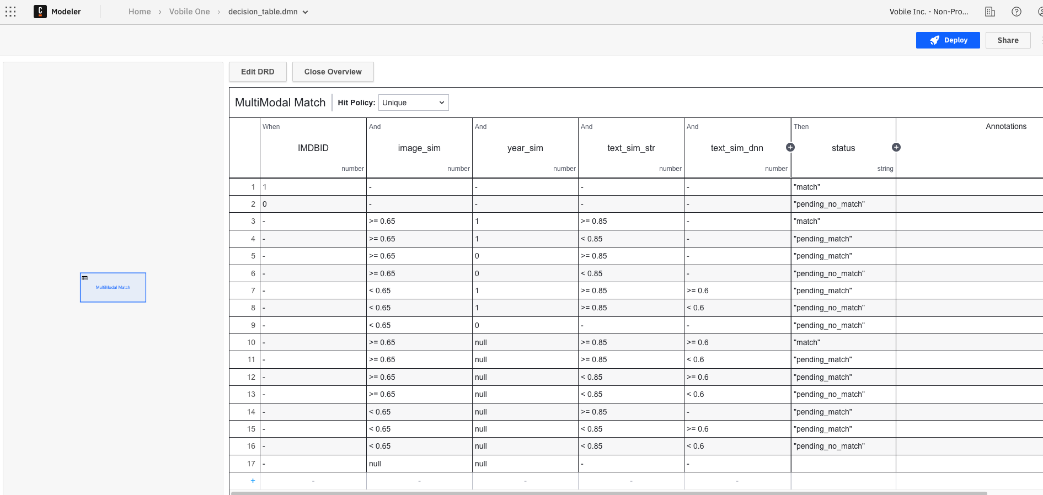
DMN
Decision
Model and
Notation
Author: Łukasz Prusiel

Slide 24

Camunda
… provides a workflow and decision automation platform offering process orchestration capabilities to organizations
Process Orchestration for end-to-end automation.
SaaS or Self-hosted
Source: https://www.camunda.com/
Author: Łukasz Prusiel

Slide 25
Camunda Components
Zeebe - the process automation engine powering Camunda Platform 8
With Zeebe you can:
Define processes graphically in BPMN 2.0.
Choose any gRPC-supported programming language to implement your workers.
Build processes that react to events from Apache Kafka and other messaging platforms.
Use as part of a software as a service (SaaS) offering with Camunda Platform 8 or deploy with Docker and Kubernetes (in the cloud or on-premises) with Camunda Platform 8 Self-Managed.
Scale horizontally to handle very high throughput.
Rely on fault tolerance and high availability for your processes.
Export processes data for monitoring and analysis (currently only available through the Elasticsearch exporter added in Camunda Platform 8 Self-Managed).
Author: Łukasz Prusiel

Slide 26
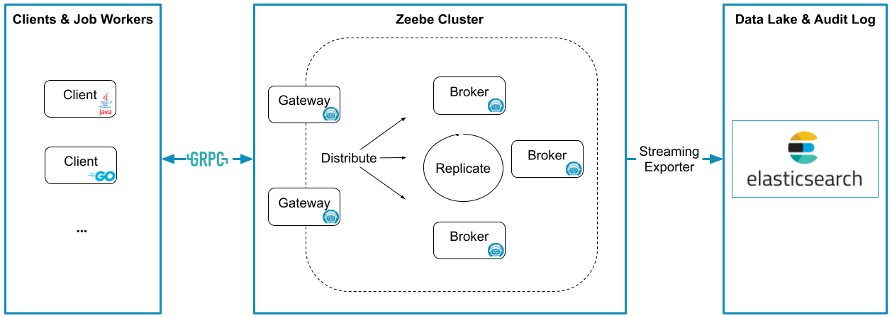
Camunda Components
Zeebe - architecture
Source: https://docs.camunda.io/docs/components/zeebe/technical-concepts/architecture/
Author: Łukasz Prusiel

Slide 27
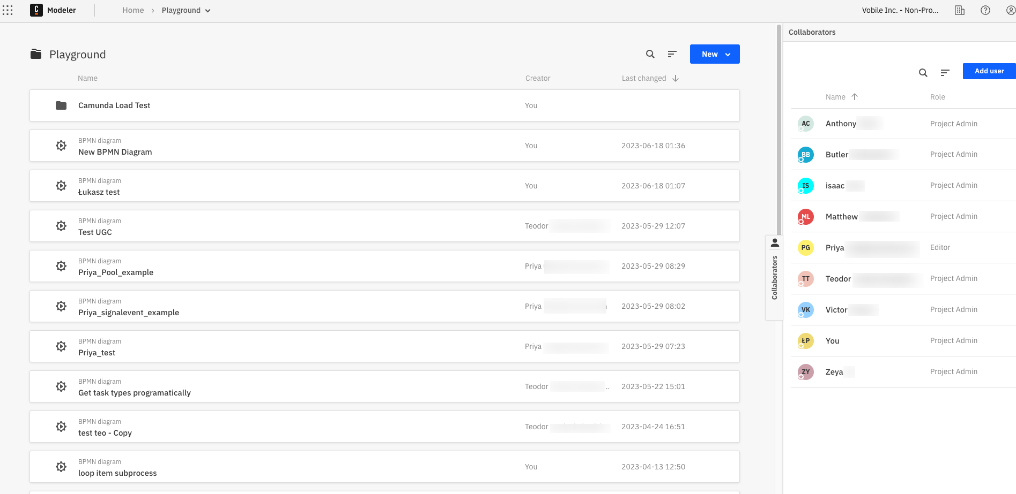
Camunda Components
Modeler
Author: Łukasz Prusiel

Slide 28
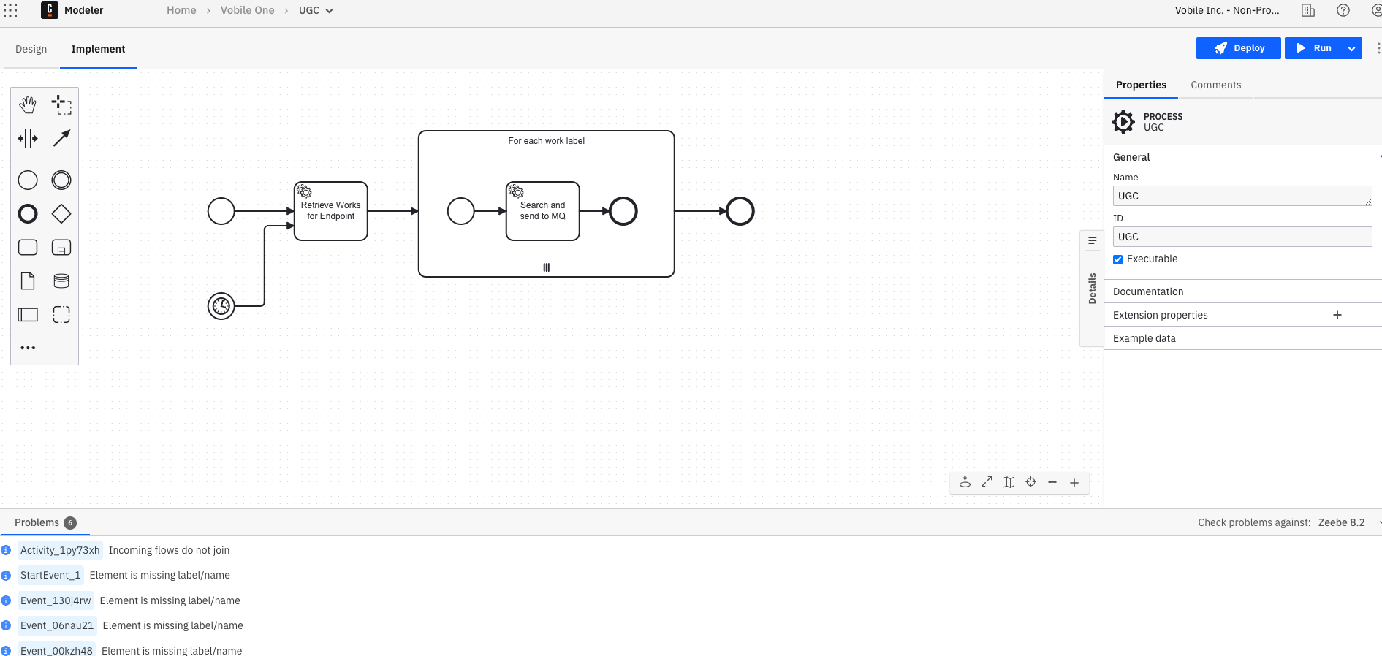
Camunda Components
Modeler
Author: Łukasz Prusiel

Slide 29
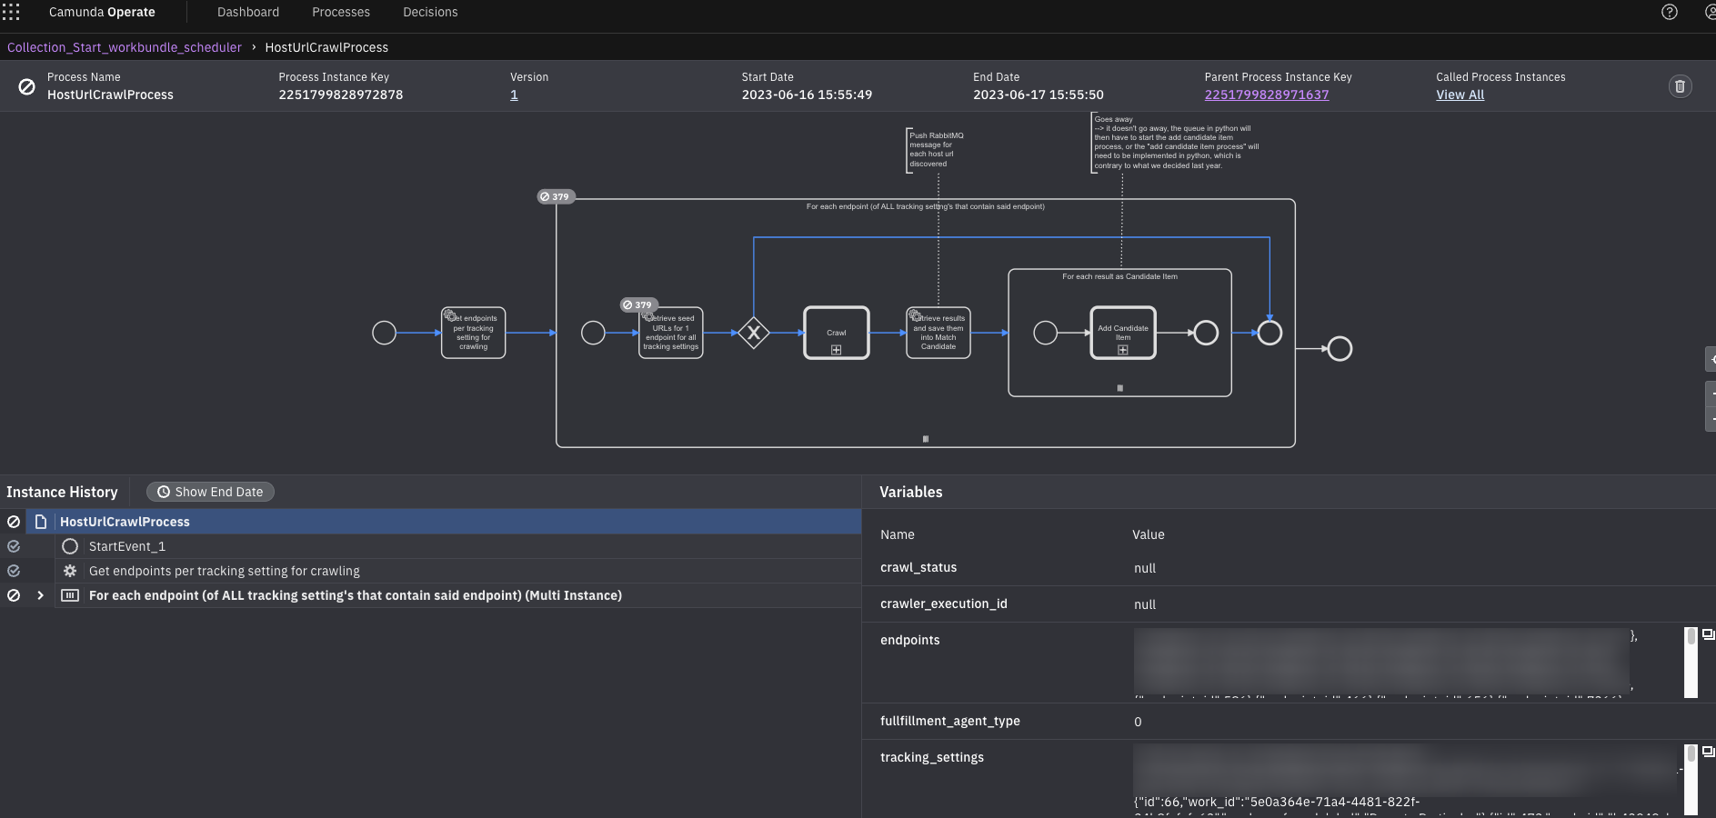
Camunda Components
Operate - Monitor
and fix running
processes
Author: Łukasz Prusiel

Slide 30
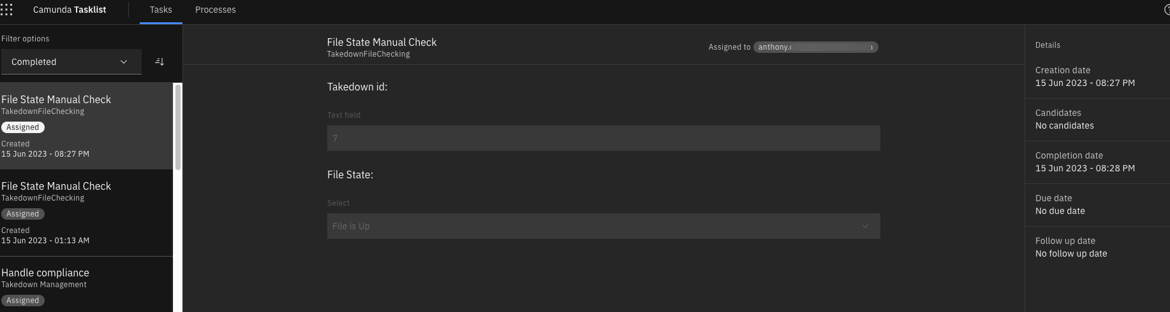
Camunda Components
Tasklist - Assign & execute user tasks
Author: Łukasz Prusiel

Slide 31
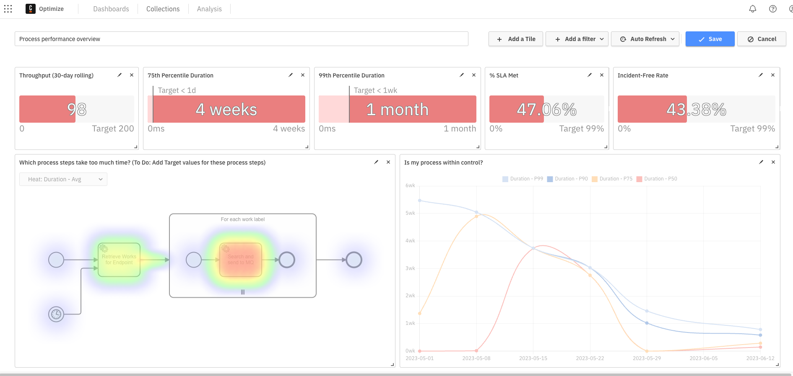
Camunda Components
Optimize -
Get insights
to improve
your
processes
Author: Łukasz Prusiel

Slide 32
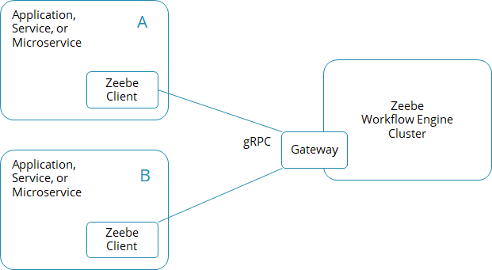
Camunda
Glue code - pyzeebe
Source: https://docs.camunda.io/docs/components/best-practices/development/connecting-the-workflow-engine-with-your-world/
Author: Łukasz Prusiel

Slide 33
Alternatives - BPMN
ActiveVOS
Activiti
Bizagi BPM
Bonita BPM
Flowable
Imixs-Workflow
jBPM
Orchestra
Sydle SEED
Author: Łukasz Prusiel

Slide 34
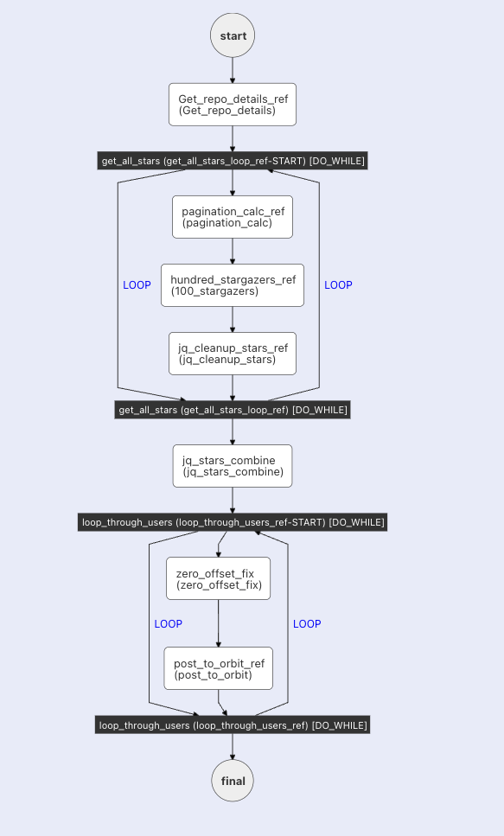
Alternatives - non-BPMN
Temporal
Cadence from Uber
Conductor from Netflix (DAG -
Directed Acyclic graph)
Author: Łukasz Prusiel

Slide 35
Thanks!
Author: Łukasz Prusiel

